Slide 1
TigerCheck v.2
Rebuilt by: Ethan Darby, Zachary White, Nick bean, Ross Spears

Slide 2
Executive Summary

Slide 3
Project Introduction

Slide 4
Requirements

Slide 5
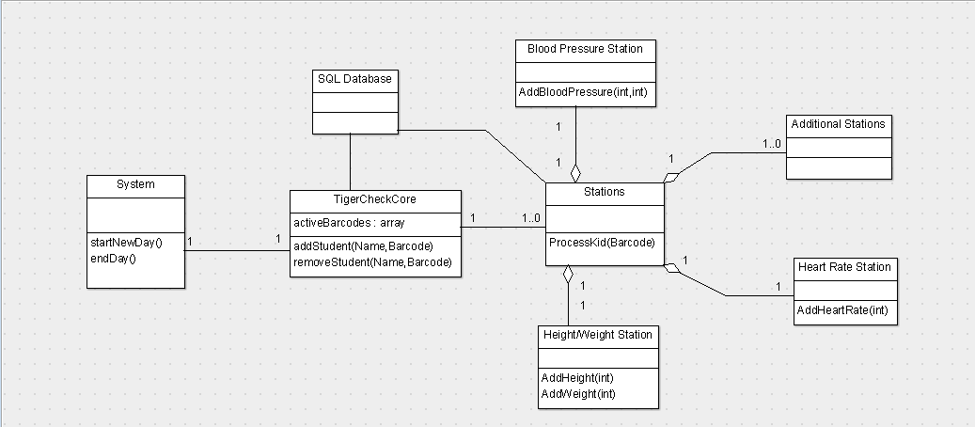
Design

Slide 6
Management

Slide 7
Risk Mitigation
Risk | Impact on Project | Probability of Occurrence | Plan to prevent
Data entered incorrectly | High | Low
Kid names not deleted when sent to state kid check. | High | Low | Create temporary database to store kids’ names and unique ids. Use the ids to connect kids to their data for parent letters.

Slide 8
Test Plan

